Slide 1
Graph Database
naresh

Slide 2
Database and its terminologies
Data
Database
Schema
DBMS
Query
Query Language

Slide 3
Types of Database
Hierarchical database.
Network database.
Object-oriented database.
Relational database.
NoSQL database.

Slide 4
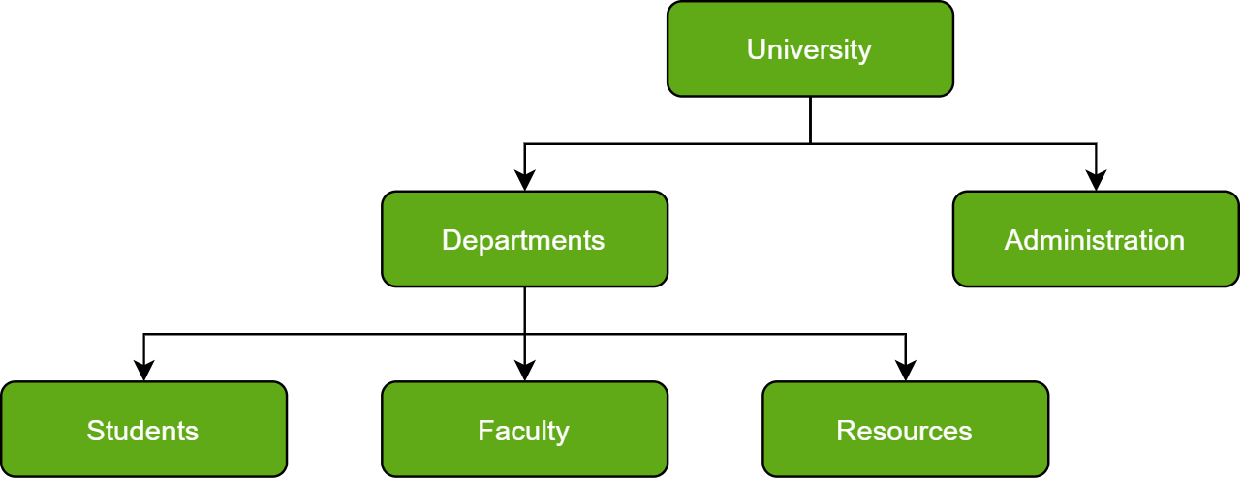
Hierarchical database

Slide 5
Just as in any hierarchy, this database follows the progression of data being categorized in ranks or levels, wherein data is categorized based on a common point of linkage.
As a result, two entities of data will be lower in rank, and the commonality would assume a higher rank.

Slide 6
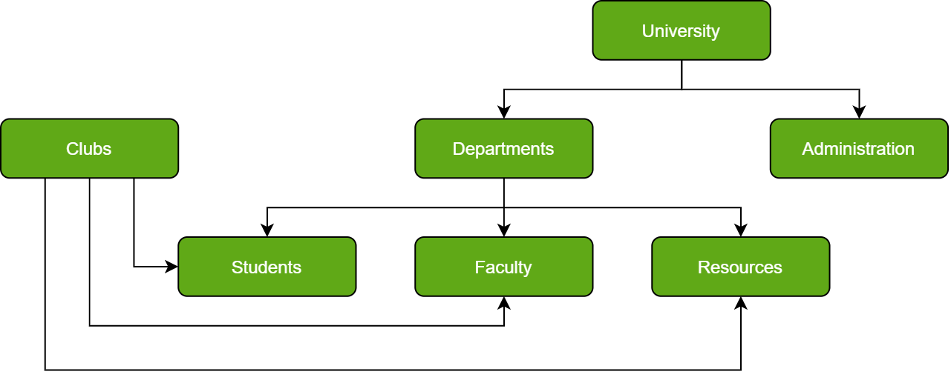
2. Network Database

Slide 7
In Layman’s terms, a network database is a hierarchical database, but with a major tweak.
The child records are given the freedom to associate with multiple parent records. As a result, a network or net of database files linked with multiple threads is observed.
Notice how the Student, Faculty, and Resources elements each have two-parent records, which are Departments and Clubs.

Slide 8
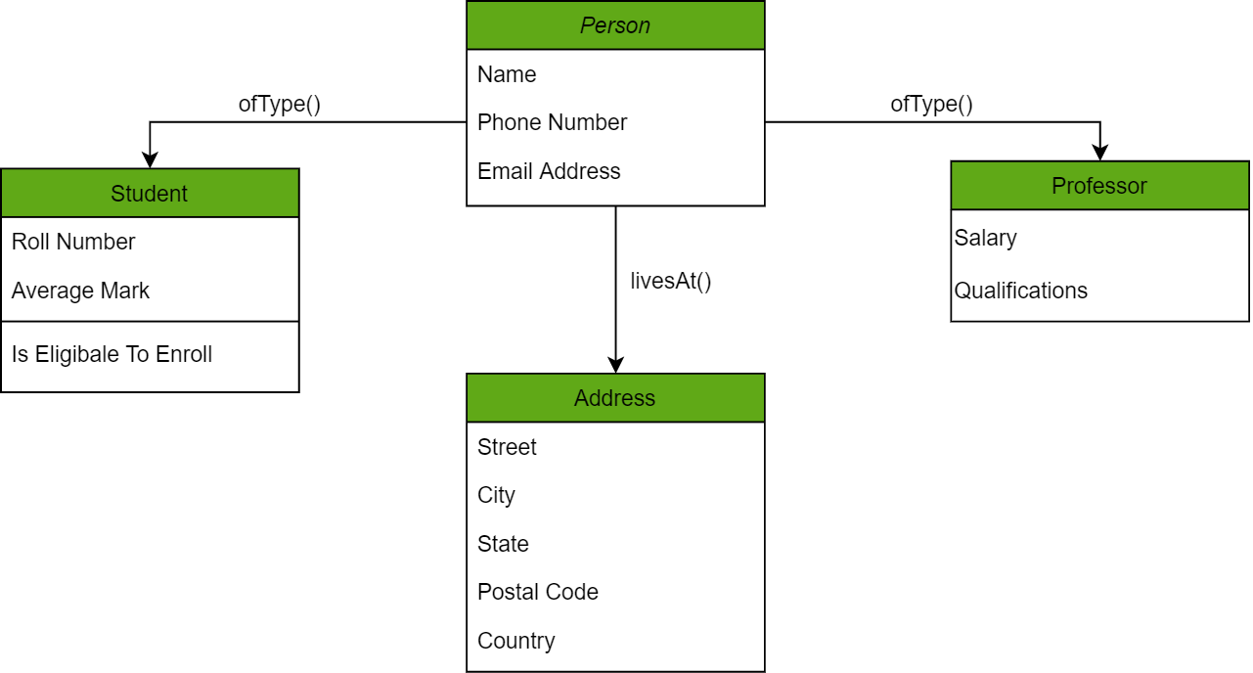
3. Object-oriented database

Slide 9
Those familiar with the Object-Oriented Programming Paradigm would be able to relate to this model of databases easily.
Information stored in a database is capable of being represented as an object which response as an instance of the database model. Therefore, the object can be referenced and called without any difficulty.
As a result, the workload on the database is substantially reduced.

Slide 10


Slide 11
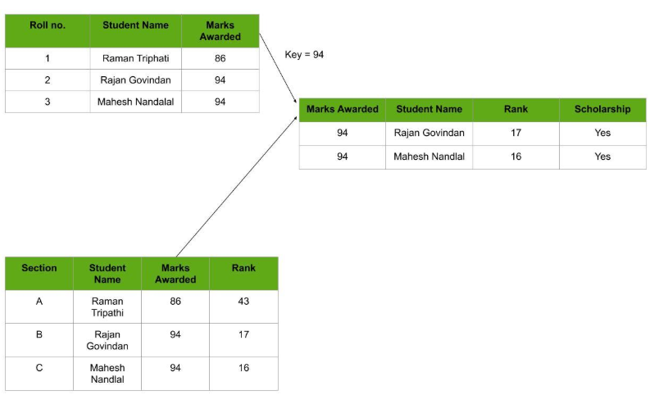
4. Relational database

Slide 12
Considered the most mature of all databases, these databases lead in the production line along with their management systems. In this database, every piece of information has a relationship with every other piece of information. This is on account of every data value in the database having a unique identity in the form of a record.
Due to this introduction of tables to organize data, it has become exceedingly popular.
It is also worth knowing in Relational databases, scaling and traversing through data is quite a light-weighted task.

Slide 13
SQL
Schema
Table
Row
Column
Primary key
Foreign key

Slide 14
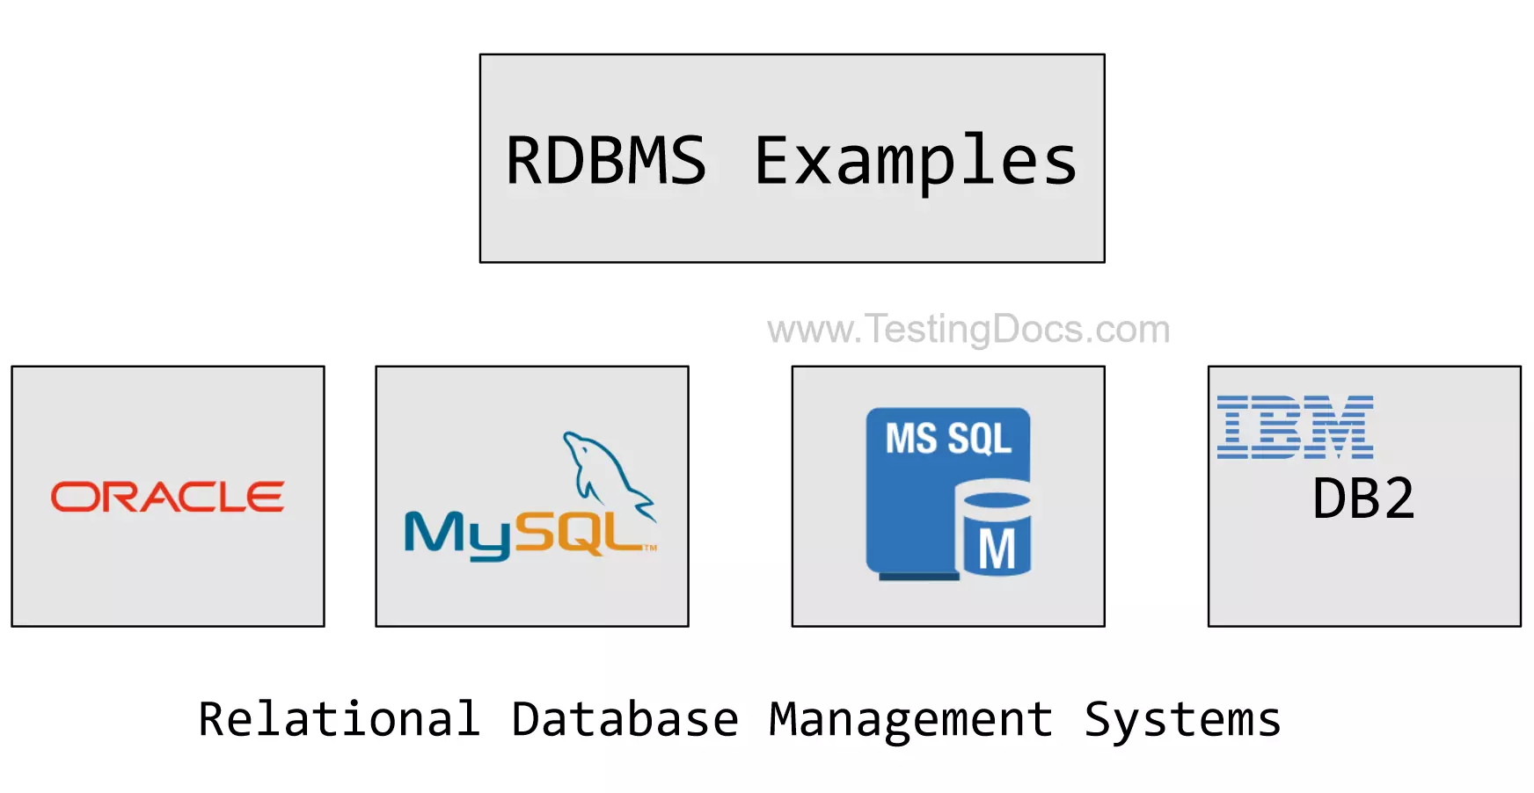

Slide 15
5. NoSQL database
A NoSQL originally referring to non-SQL or non-relational is a database that provides a mechanism for storage and retrieval of data. This data is modeled in means other than the tabular relations used in relational databases.
A NoSQL database includes simplicity of design, simpler horizontal scaling to clusters of machines, and finer control over availability.The suitability of a given NoSQL database depends on the problem it should solve. Data structures used by NoSQL databases are sometimes also viewed as more flexible than relational database tables.
eg., elasticsearch

Slide 16
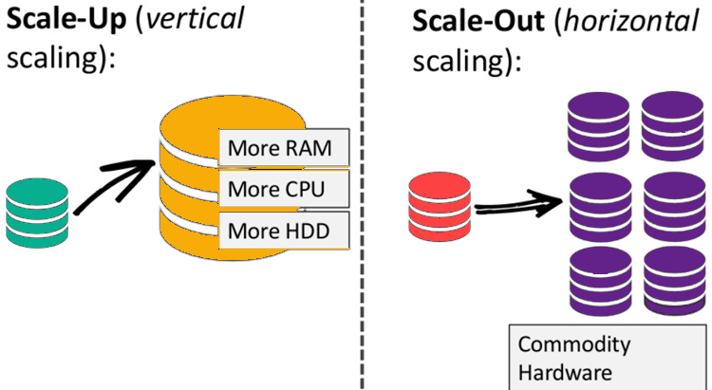
Advantage over RDBMS

Slide 17
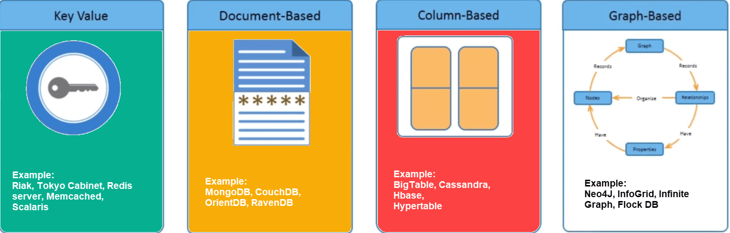
Types of NoSQL DB

Slide 18
Key Value Pair Based
Data is stored in key/value pairs. It is designed in such a way to handle lots of data and heavy load.
Key-value pair storage databases store data as a hash table where each key is unique, and the value can be a JSON, BLOB(Binary Large Objects), string, etc.
Redis, Dynamo, Riak are some NoSQL examples of key-value store Databases. They are all based on Amazon’s Dynamo paper.

Slide 19
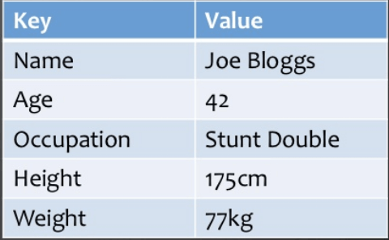

Slide 20
2. Column-based
Column-oriented databases work on columns and are based on BigTable paper by Google. Every column is treated separately. Values of single column databases are stored contiguously.
In this data is stored in cells grouped in columns of data rather than as rows of data.
They deliver high performance on aggregation queries like SUM, COUNT, AVG, MIN etc. as the data is readily available in a column.
HBase, Cassandra, HBase, Hypertable are NoSQL query examples of column-based database.

Slide 21
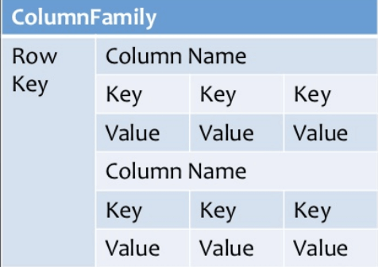

Slide 22
3. Document-Oriented
Document-Oriented NoSQL DB stores and retrieves data as a key value pair but the value part is stored as a document. The document is stored in JSON or XML formats. The value is understood by the DB and can be queried.
The document type is mostly used for CMS systems, blogging platforms, real-time analytics & e-commerce applications. It should not use for complex transactions which require multiple operations or queries against varying aggregate structures.
Amazon SimpleDB, CouchDB, MongoDB, Riak, Lotus Notes, MongoDB, are popular Document originated DBMS systems.

Slide 23
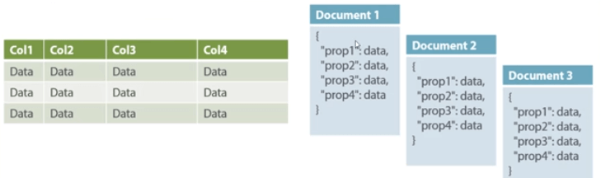

Slide 24
4. Graph-Based
A graph type database stores entities as well the relations amongst those entities. The entity is stored as a node with the relationship as edges. An edge gives a relationship between nodes. Every node and edge has a unique identifier.
Graph database is a multi-relational in nature. Traversing relationship is fast as they are already captured into the DB, and there is no need to calculate them.
Graph base database mostly used for social networks, logistics, spatial data.
Neo4J, Infinite Graph, OrientDB, FlockDB.

Slide 25
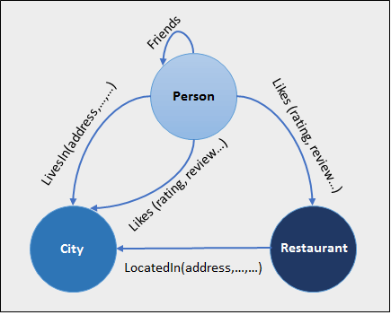

Slide 26
What is graphDB?
A graph database stores nodes and relationships instead of tables, or documents.
Data is stored just like you might sketch ideas on a whiteboard.
It defined as a specialized, single-purpose platform for creating and manipulating graph.
A graph is a pictorial representation of a set of objects where some pairs of objects are connected by links. It is composed of two elements - nodes (vertices) and relationships (edges).

Slide 27
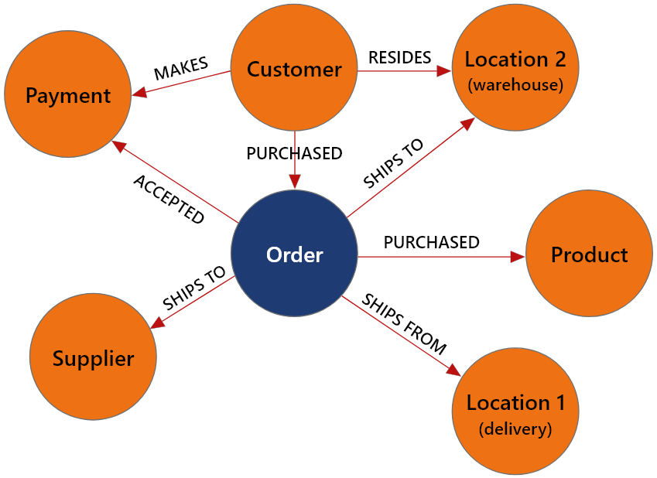
Popular graphdb
Neo4j is a popular Graph Database.
Other Graph Databases are Oracle NoSQL Database, OrientDB, HypherGraphDB, GraphBase, InfiniteGraph, and AllegroGraph.

Slide 28
Why Graph Databases?
Nowadays, most of the data exists in the form of the relationship between different objects and more often, the relationship between the data is more valuable than the data itself.
Relational databases store highly structured data which have several records storing the same type of data so they can be used to store structured data and, they do not store the relationships between the data.
Unlike other databases, graph databases store relationships and connections as first-class entities.

Slide 29
RDBMS Vs Graph Database
RDBMS | Graph Database
Tables | Graphs
Rows | Nodes
Columns and Data | Properties and its values
Constraints | Relationships
Joins | Traversal

Slide 30
Neo4j
Neo4j is the world's leading open source Graph Database which is developed using Java technology. It is highly scalable and schema free (NoSQL).
Postgres uses SQL, likewise neo4j uses cipher.

Slide 31

Thanks

